Slide 1
Rating AFL Teams and Modelling Australian Rules Football
August 2016

Slide 2
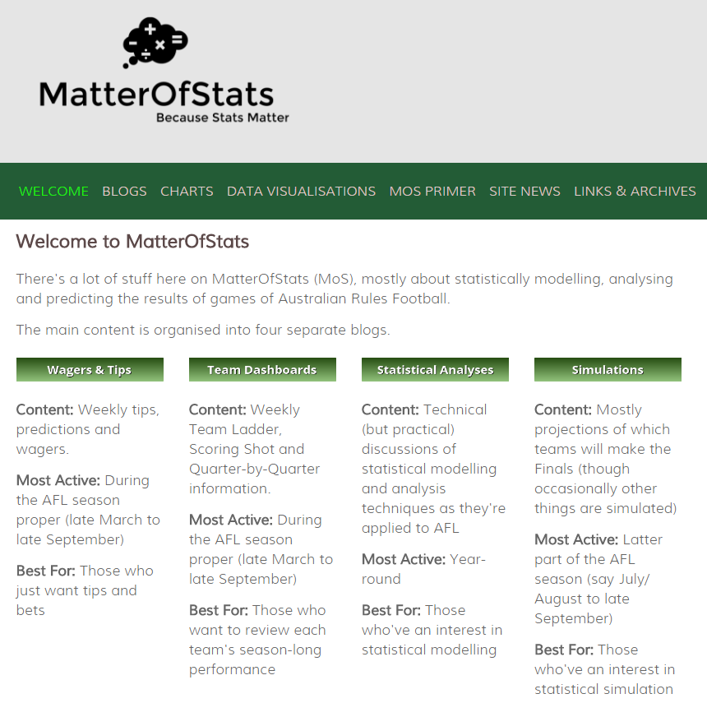
MatterOfStats
Operating since 2006
Rate teams
Predict outcomes
Project seasons
Analyse history and results

Slide 3
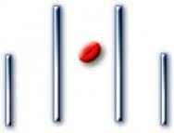
Aussie Rules 101
Two teams of 22 players, 18 on the field at any one time
4 x 20-minute quarters with time-on for stoppages
Typical game lasts about 3 hours
Two methods of scoring
18 teams in the competition
Home-and-away
season lasts for 24 weeks
Top 8 teams play Finals
1 point
(Behind)
6 points
(Goal)
1 point
(Behind)
3

Slide 4
MoSSBODS: The Basic System

Slide 5
Rating Teams
MoSSBODS: An ELO-style system
Raw performances are adjusted to reflect the relative abilities of the opponent faced
Ratings are measured in Scoring Shots
  eg a +3 SS Offensive Rating means that a team is expected to score 3 Scoring Shots more than an average team against an average opponent at a neutral venue
Major components
Offensive and Defensive Rating for all 18 teams (sum is normed to 0)
Team Venue Performance Values for all teams at all Venues (set to 0 until 30 games have been played at a Venue)
Travel Penalty for playing Interstate
5

Slide 6
Updating Ratings
Varies across the season – 0.15, 0.10, 0.10, 0.075, 0.10
Set of Updating Equations
(1) New Defensive Rating = Old Defensive Rating + k x (Actual Defensive Performance – Expected Defensive Performance)
(2) Actual Defensive Performance = All-Team Scoring Shot Average – Adjusted Opponent’s Scoring Shots
(3) Expected Defensive Performance = Own Defensive Rating – Opponent’s Offensive Rating + Venue Adjustment / 2
(4) Adjusted Opponent’s Scoring Shots = min(Scoring Shot Cap, Actual Opponent’s Scoring Shots)
(5) Venue Adjustment = Net Venue Performance + Net Travel Penalty
Similar equations are used to update Offensive Ratings
Use average across previous season
Effectively not required
6

Slide 7
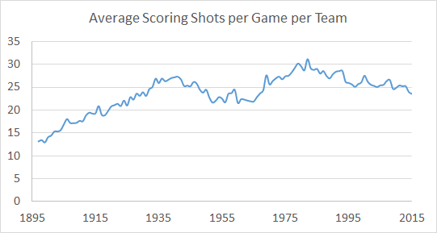
Scoring Shot History
The previous season’s Average Scoring Shots per Game is a reasonable estimate of the current season’s
cor(Average Year_{t} , Average Year_{t-1}) = +0.963
2016: 24.2
7

Slide 8
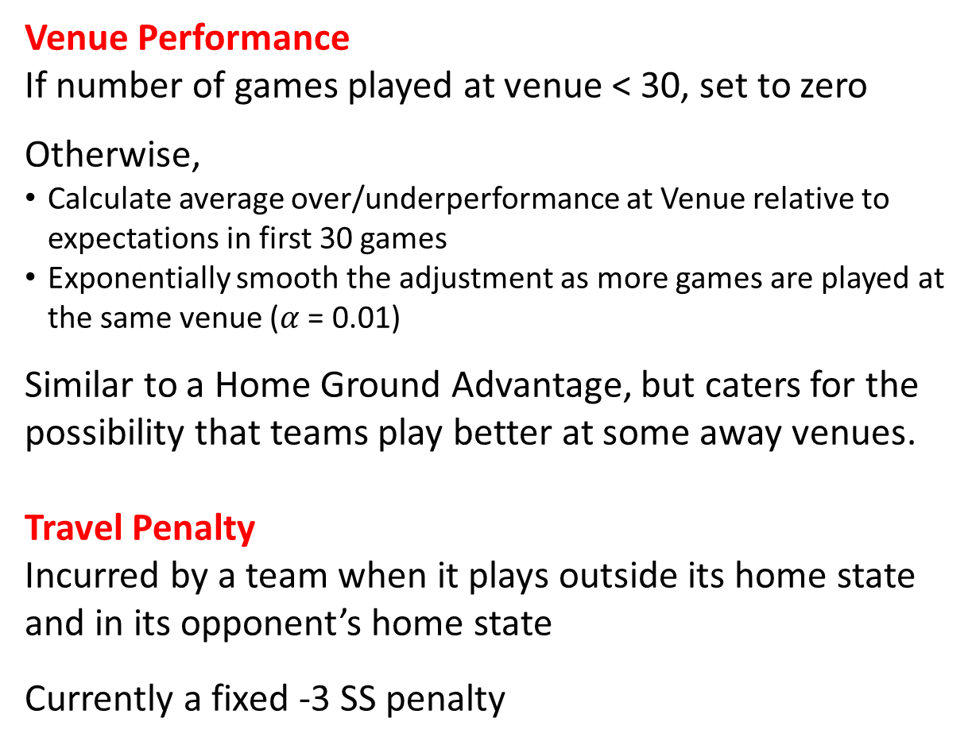
Impact of Venue
Venue Performance
If number of games played at venue < 30, set to zero
Otherwise,
Calculate average over/underperformance at Venue relative to expectations in first 30 games
Exponentially smooth the adjustment as more games are played at the same venue ($α$ = 0.01)
Similar to a Home Ground Advantage, but caters for the possibility that teams play better at some away venues.
Travel Penalty
Incurred by a team when it plays outside its home state and in its opponent’s home state
Currently a fixed -3 SS penalty
8

Slide 9
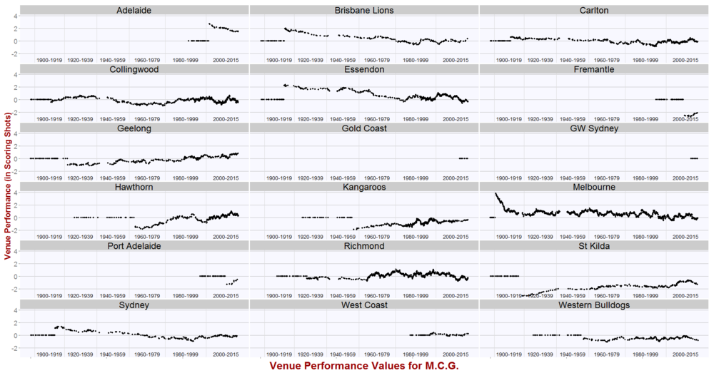
Venue Performance History: M.C.G
Once established, a team’s Venue Performance Value for a venue moves only slowly.
9

Slide 10

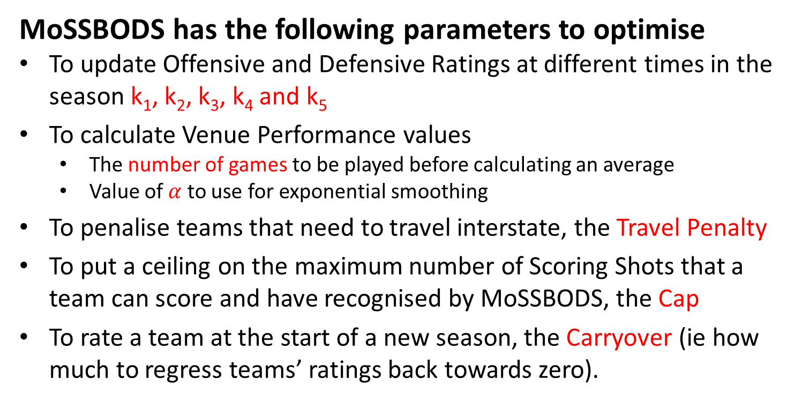
Parameter Optimisation
MoSSBODS has the following parameters to optimise
To update Offensive and Defensive Ratings at different times in the season k₁, k₂, k₃, k₄ and k₅
To calculate Venue Performance values
  The number of games to be played before calculating an average
  Value of $α$ to use for exponential smoothing
To penalise teams that need to travel interstate, the Travel Penalty
To put a ceiling on the maximum number of Scoring Shots that a team can score and have recognised by MoSSBODS, the Cap
To rate a team at the start of a new season, the Carryover (ie how much to regress teams’ ratings back towards zero).
These parameters were optimised via a grid search with mean absolute error the metric to be minimised
$$MAE= \frac{\sum_{i=1}^{n}{\left|{Actual Margin}_{i}−{Predicted Margin}_{i}\right|}}{n}$$
10

Slide 11
Performance

Slide 12
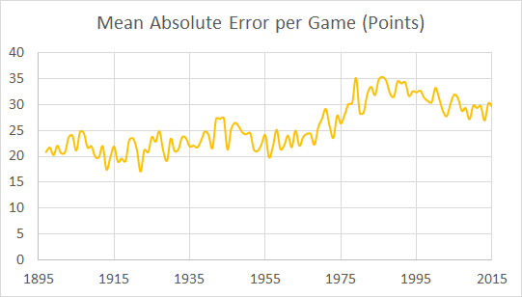
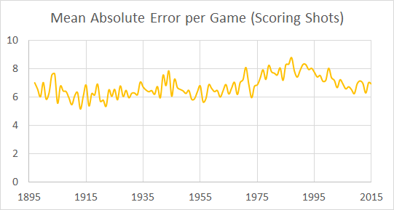
Mean Absolute Error
MoSSBODS MAEs for entire seasons have generally finished in the 20 to 35 points per game range.
That’s comparable with the performance of professional bookmakers.
Measuring error in terms of Scoring Shots rather than Points, we see that MAEs have varied between about 5 and 9 Scoring Shots per game.
12

Slide 13
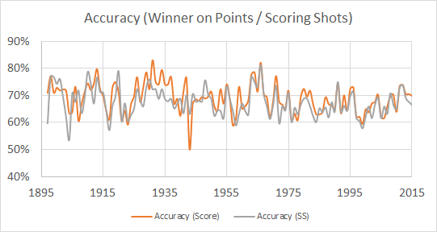
Predictive Accuracy
Using a cruder metric, Accuracy, which takes on a value of 1 when MoSSBODS predicts correctly, 0 when it predicts incorrectly, and 0.5 when there’s a drawn game, MoSSBODS is usually right about 60 to 70% of the time.
13

Slide 14
2016 Results: Home and Away Season
Accuracy
147 / 198 = 74%
Margin Prediction
MAE = 30.2 points per game
Log Probability Score
+0.2181 per game
14

Slide 15
Ratings History

Slide 16
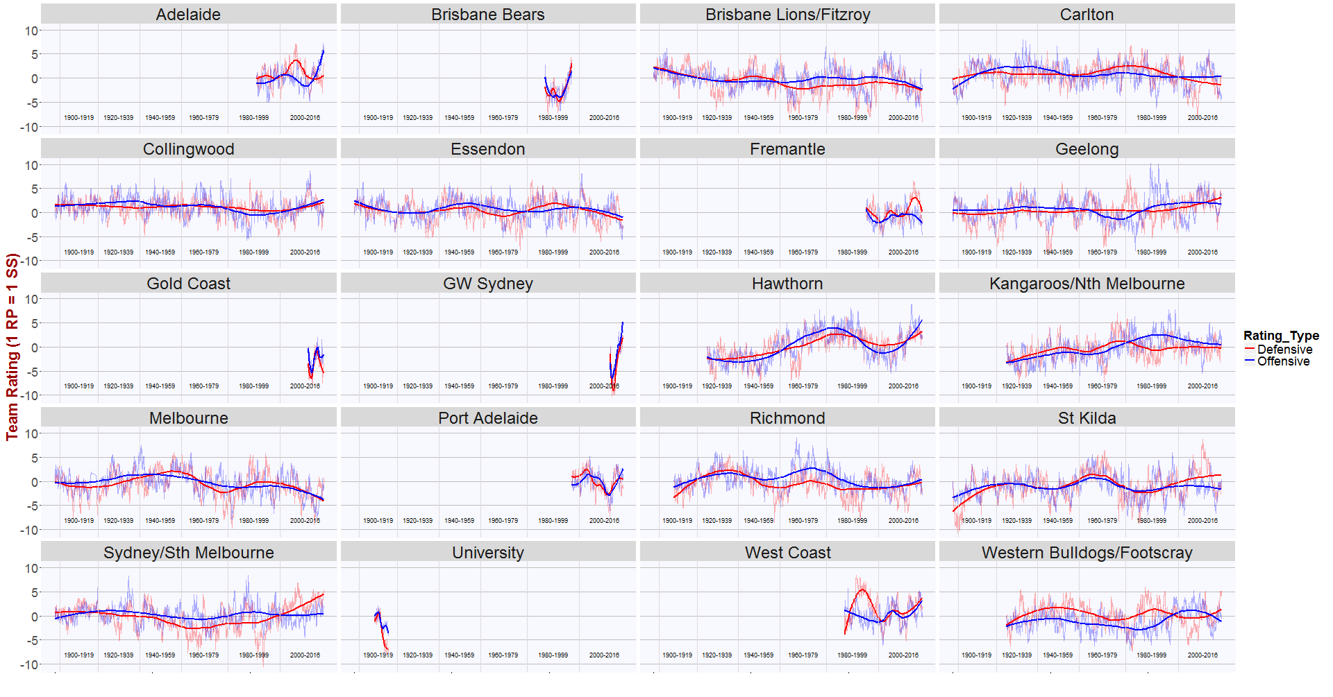
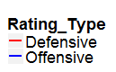
Historical Ratings: Offensive & Defensive
16

Slide 17
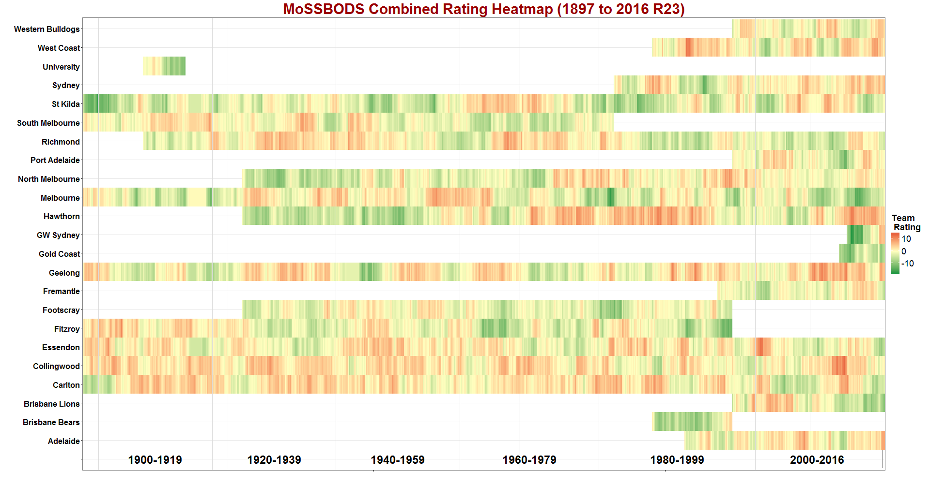
Historical Ratings: Combined All-Time
17

Slide 18
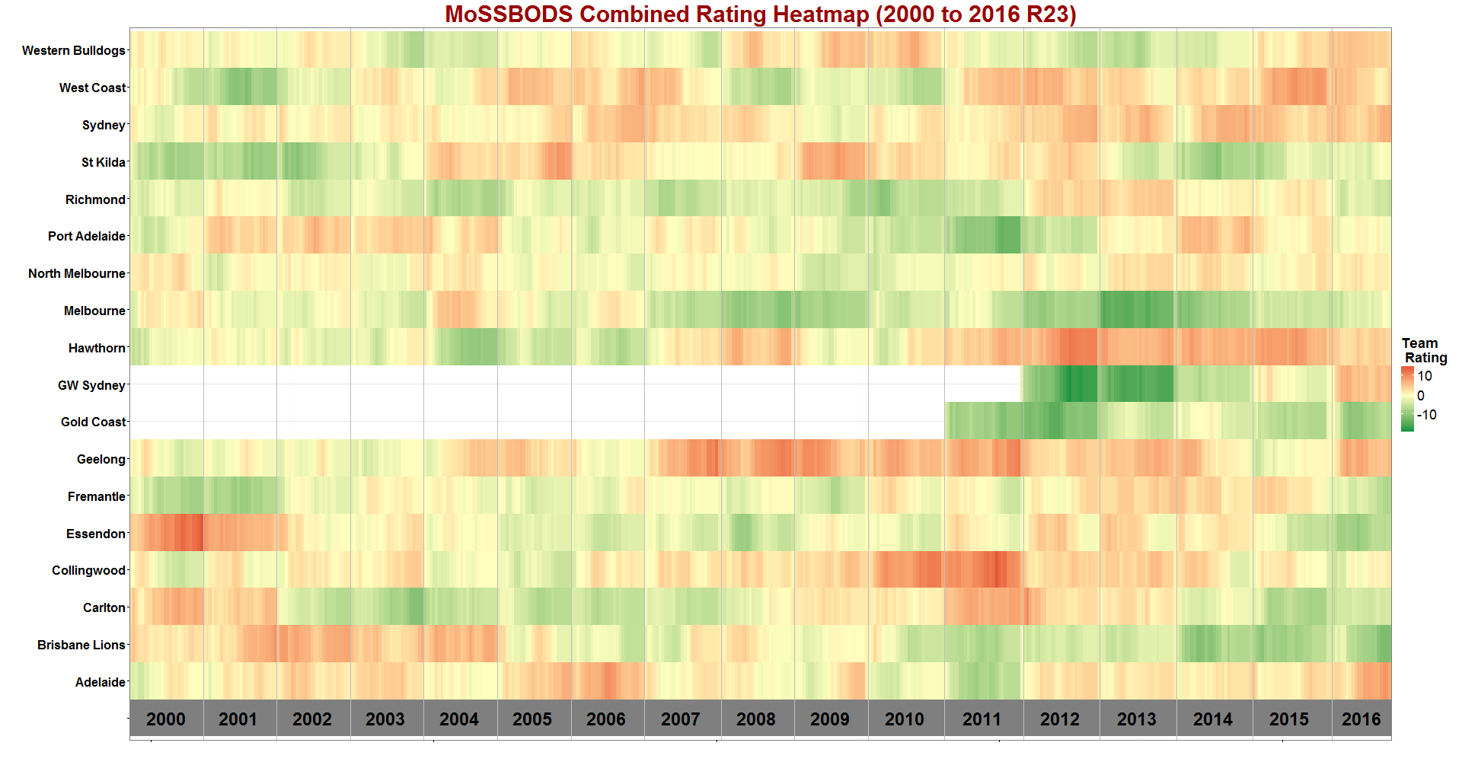
Historical Ratings:Combined 2000-2016
18

Slide 19
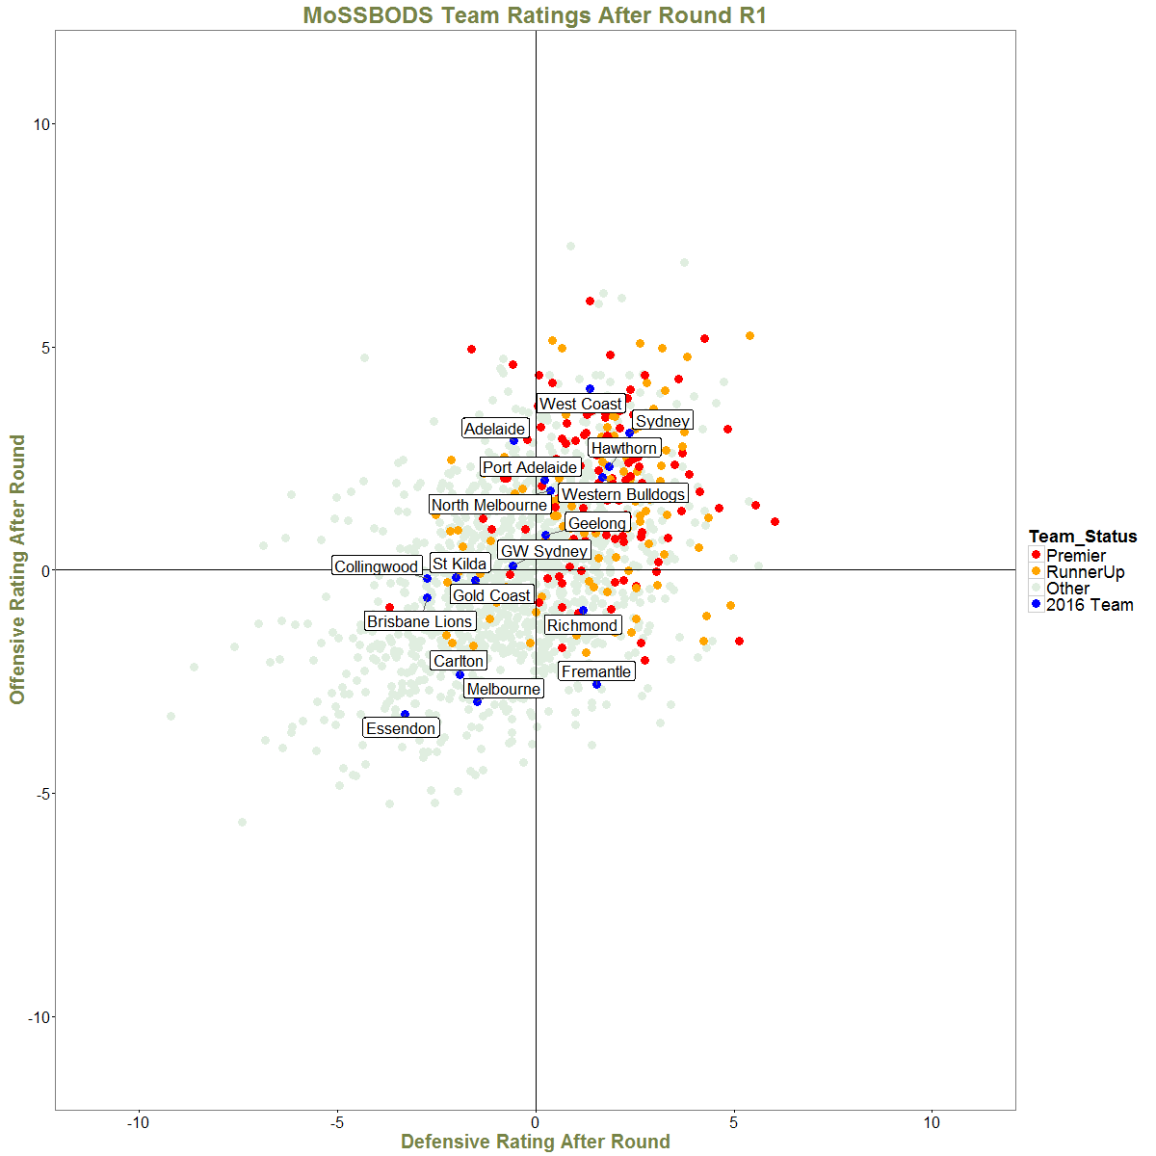
The 2016 Season
19

Slide 20
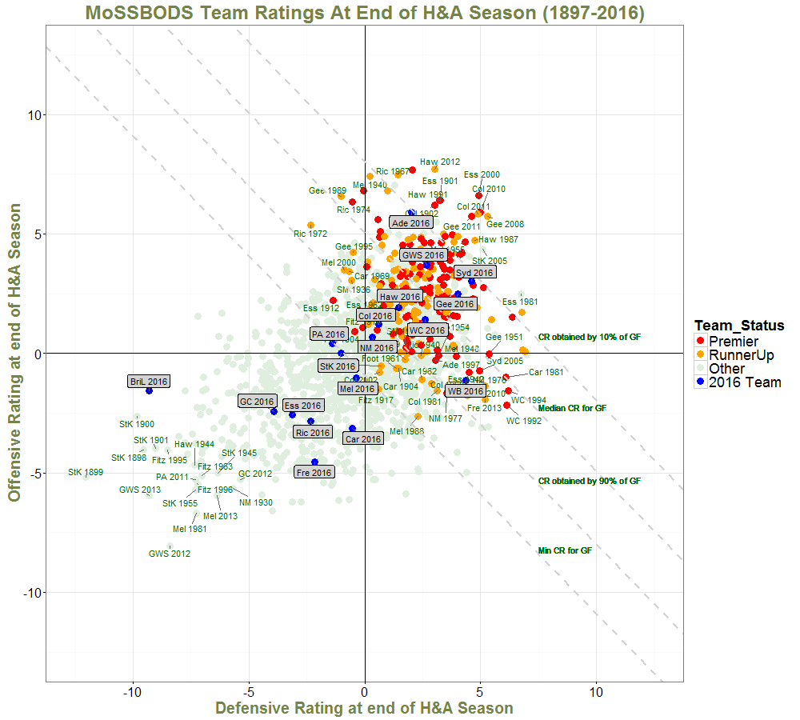
End of Home and Away Season (All)
20

Slide 21
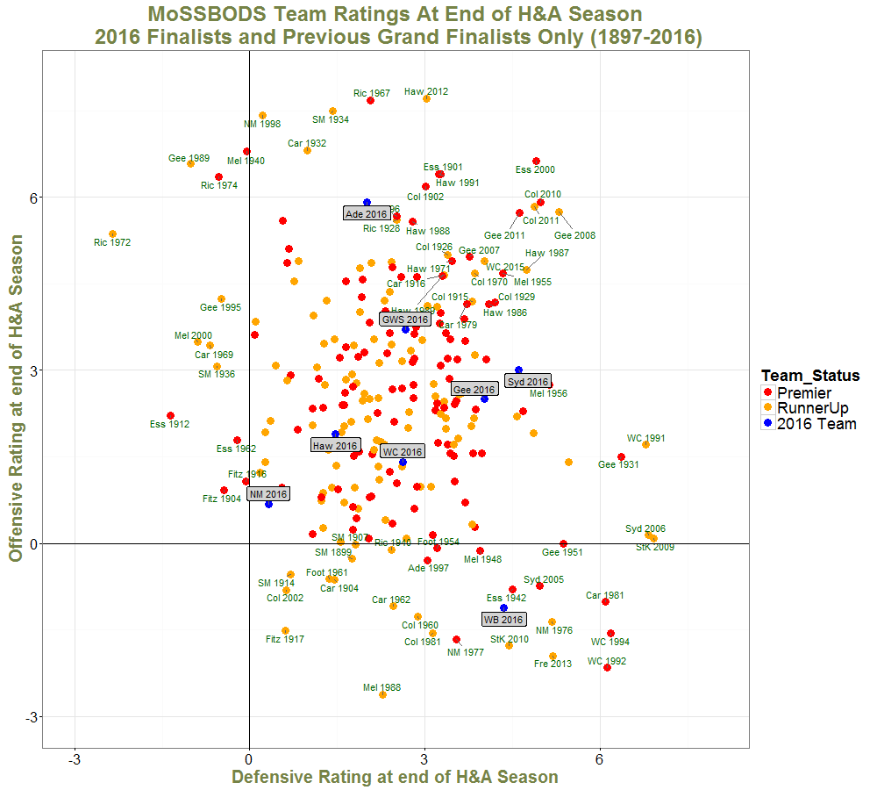
End of Home and Away Season (GF)
21

Slide 22
Projecting Future Results

Slide 23
Projecting Game Results: Scoring Shots
Own Expected Scoring Shots =
All-Team Scoring Shot Average +
Own Offensive Rating – Opponent Defensive Rating +
[(Own Venue Performance – Opponent Venue Performance) + (Own Travel Penalty – Opponent Travel Penalty)]/2
Opponent Expected Scoring Shots =
All-Team Scoring Shot Average +
Opponent Offensive Rating – Own Defensive Rating +
[(Opponent Venue Performance – Own Venue Performance) + (Opponent Travel Penalty – Own Travel Penalty)]/2
23

Slide 24
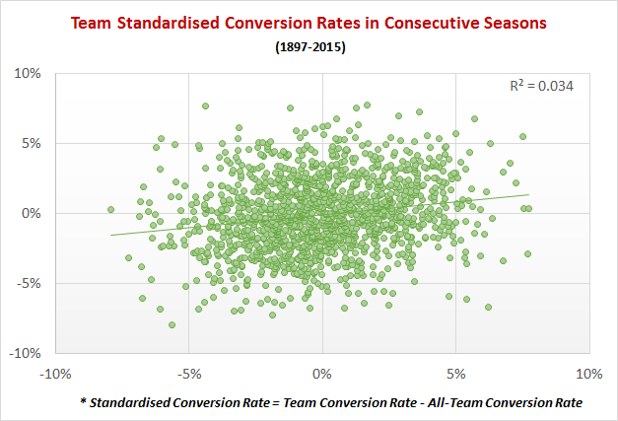
Conversion Rates
Empirical evidence is that a team’s Scoring Shot Conversion Rate in a game – the proportion of Scoring Shots that it converts into goals – is nearly random
24

Slide 25
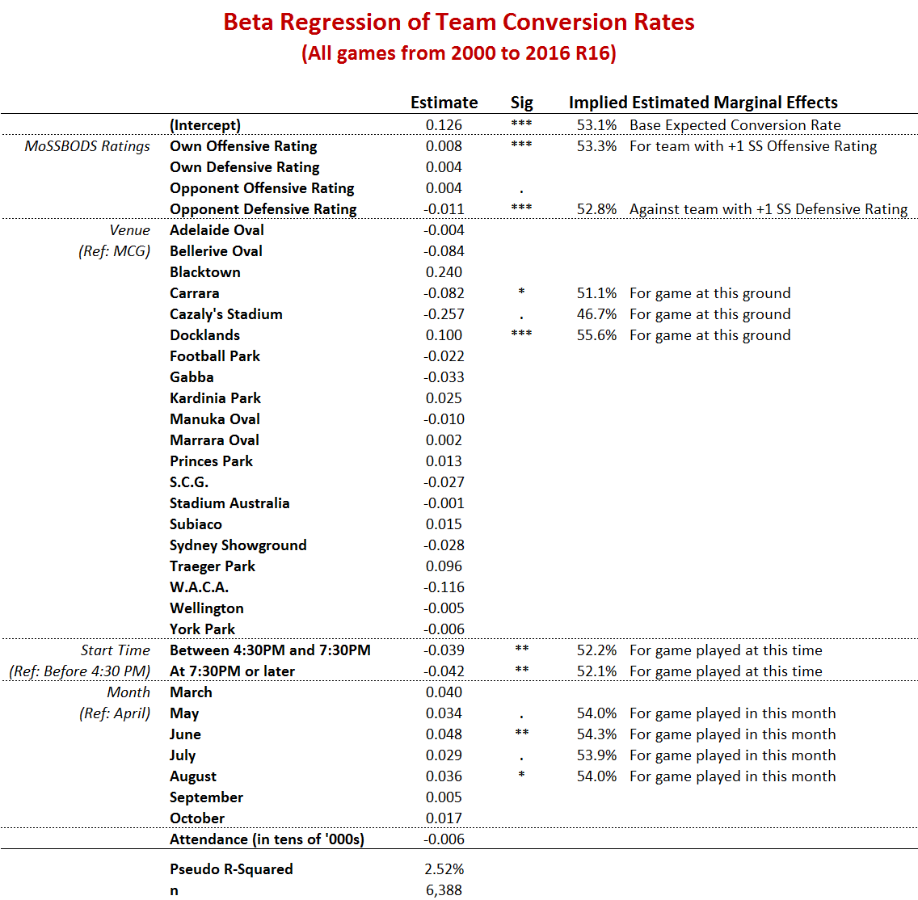
Predicting Conversion Rates
Conversion depends on a team’s Offensive strength and the Defensive strength of its opponent in a game …
… is higher or lower at a handful of venues …
… is lower in games that start later …
… is higher at particular times of the season …
… is unaffected by attendance …
… and remains, largely, unexplained …
25

Slide 26
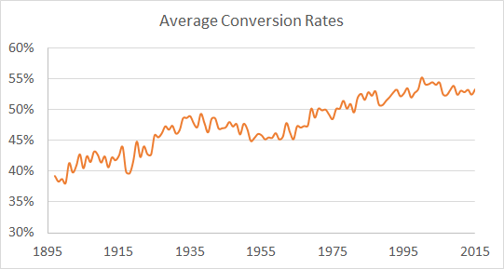
Historical Conversion Rates
The previous season’s Average Conversion rate is a reasonable estimate of the current season’s
cor(Average Year_{t} , Average Year_{t-1}) = +0.929
2016: 53.2%
26

Slide 27
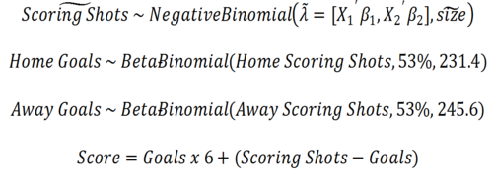
Projecting the Results of a Game
Model
Scoring Shots as a bivariate Negative Binomial (to reflect correlation)
Goals as two, independent Beta Binomials
Use the expected Home and Away Team Scoring Shot estimates
{E(SS_{Home}),E(SS_{Away})}
E(Conv), Theta_{Home})
E(Conv), Theta_{Away})
Use the all-team average from the previous season
27

Slide 28
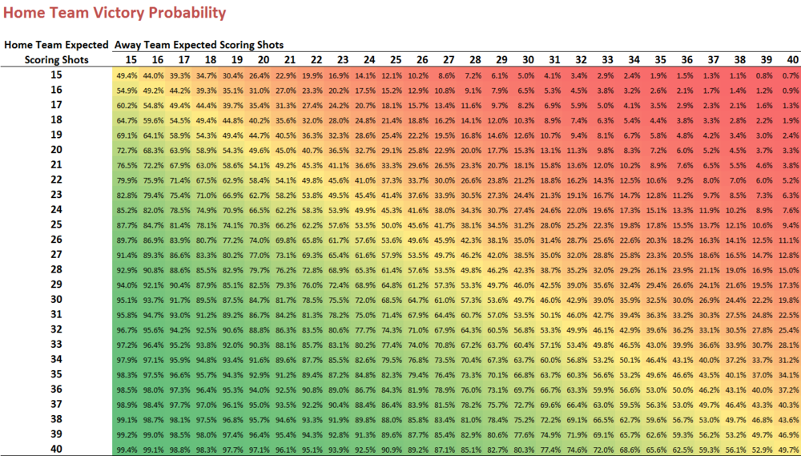
Inferring Probabilities
A Home team expected to generate 25 Scoring Shots will beat an Away team expected to generate 20 Scoring Shots about 70% of the time.
28

Slide 29
Projecting Seasons
Results from Games Played
Current Ratings and Venue Performance Values
Simulate Results for Remaining Games
Distribution of Final Ladder Positions
Add additional randomness by treating on-the-day team ratings as random variables
Actual Ability on Day ~ N(Current Rating, 0.5)
Remaining Schedule
29

Slide 30
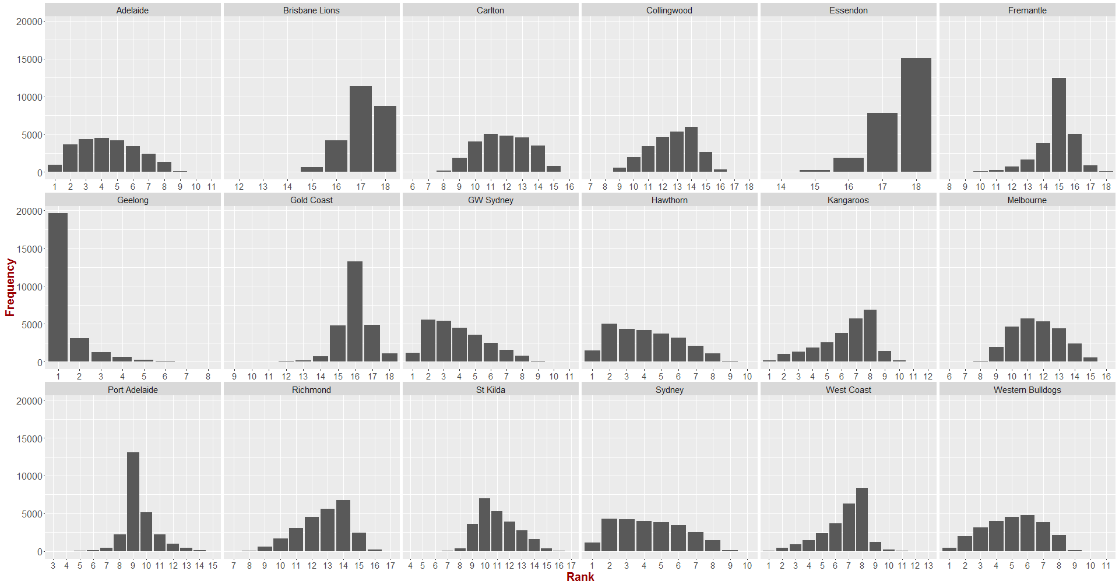
Projecting Seasons
After Round 13
30

Slide 31
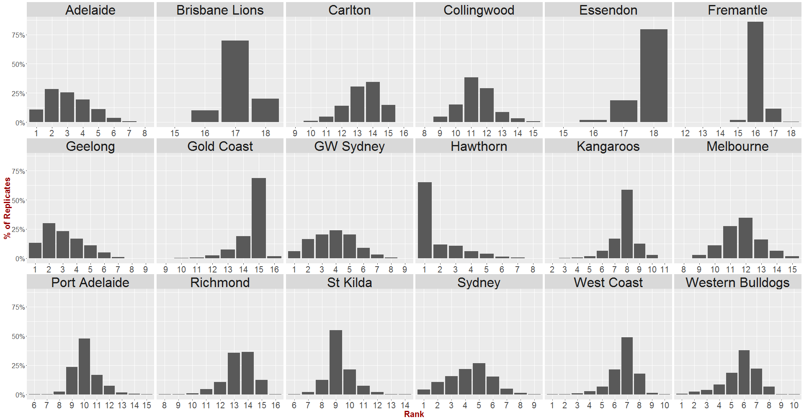
Projecting Seasons
After Round 18
31

Slide 32
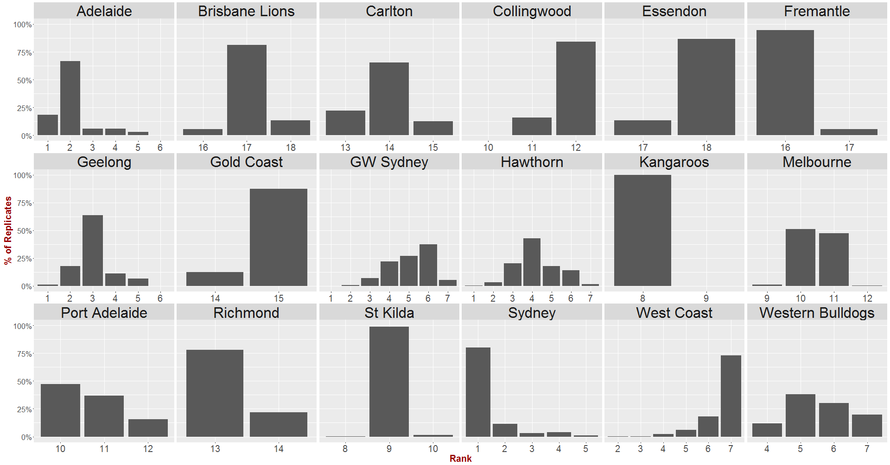
Projecting Seasons
After Round 22
32

Slide 33
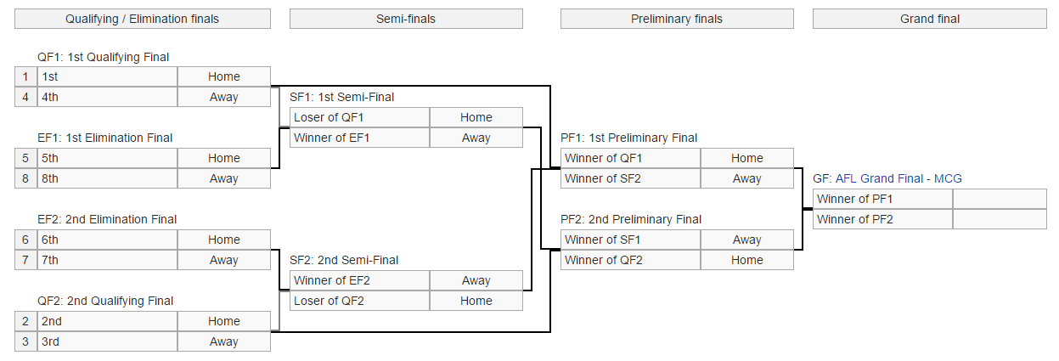
Projecting the Finals
Finals System & Venuing Rules
Probabilities Related to the Finals
33

Slide 34
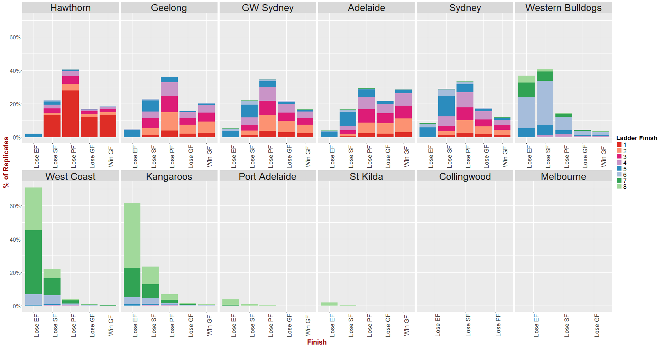
Projecting the Finals
After Round 19
34

Slide 35
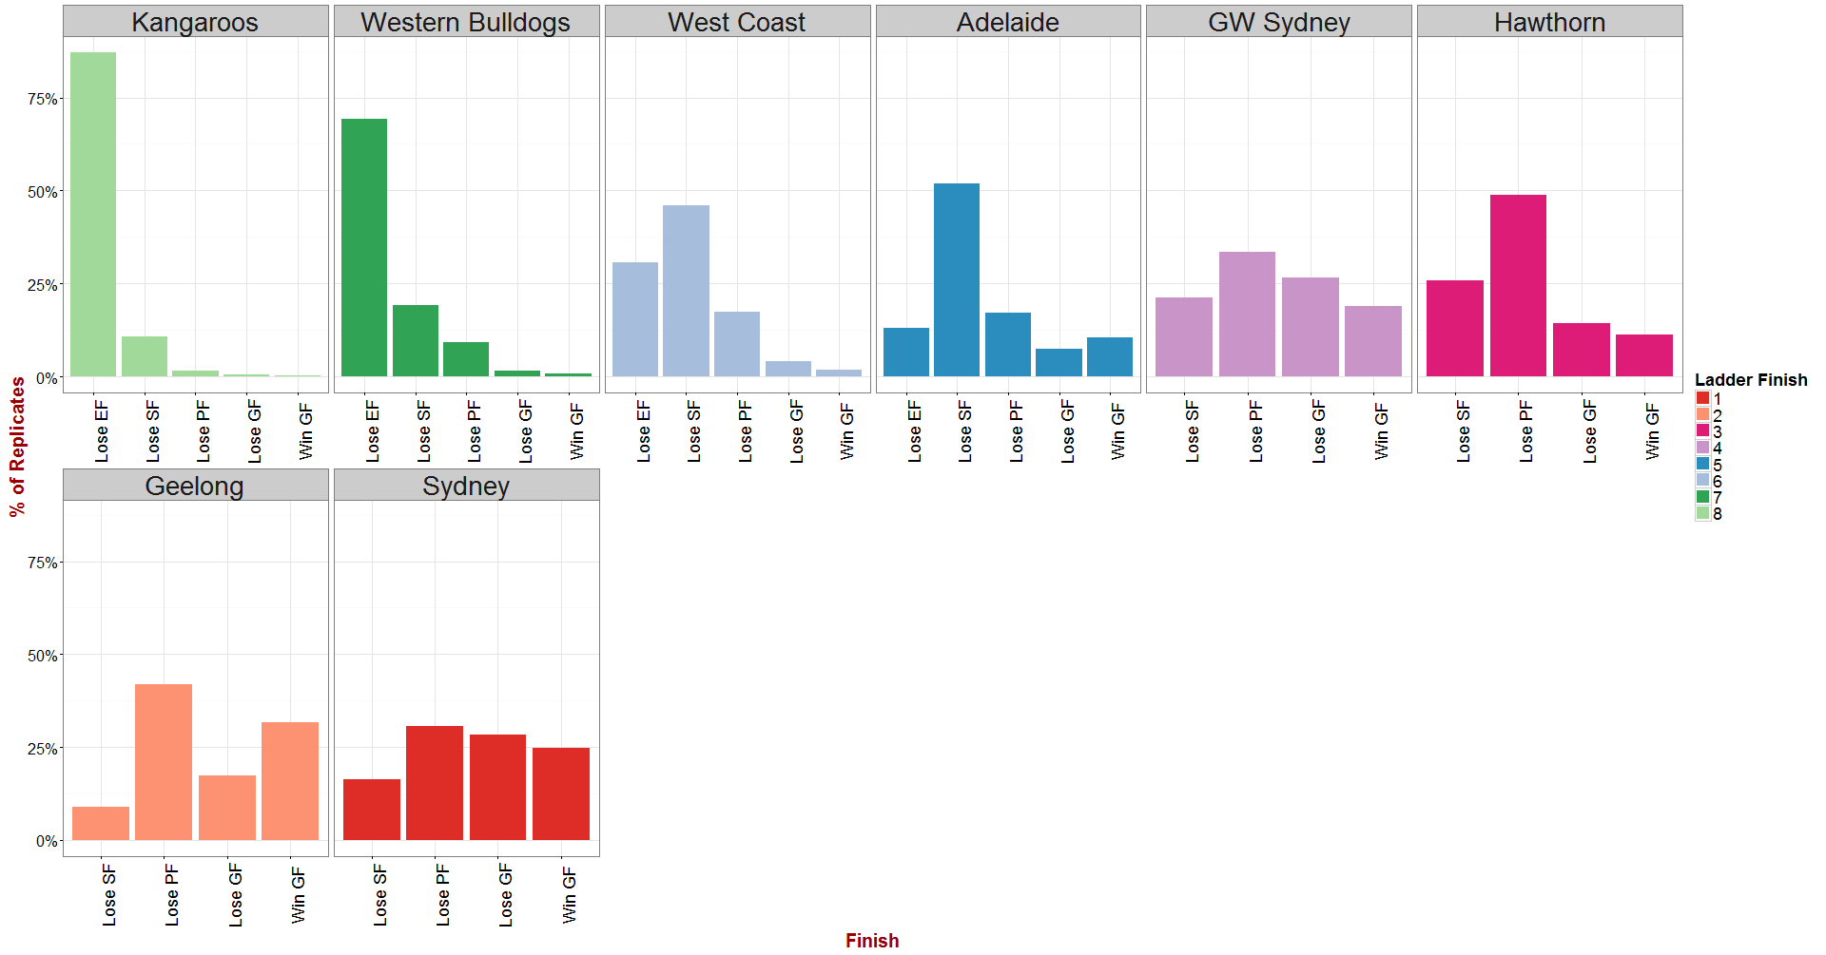
Latest Projections
35

Slide 36
Some Other Visualisations

Slide 37
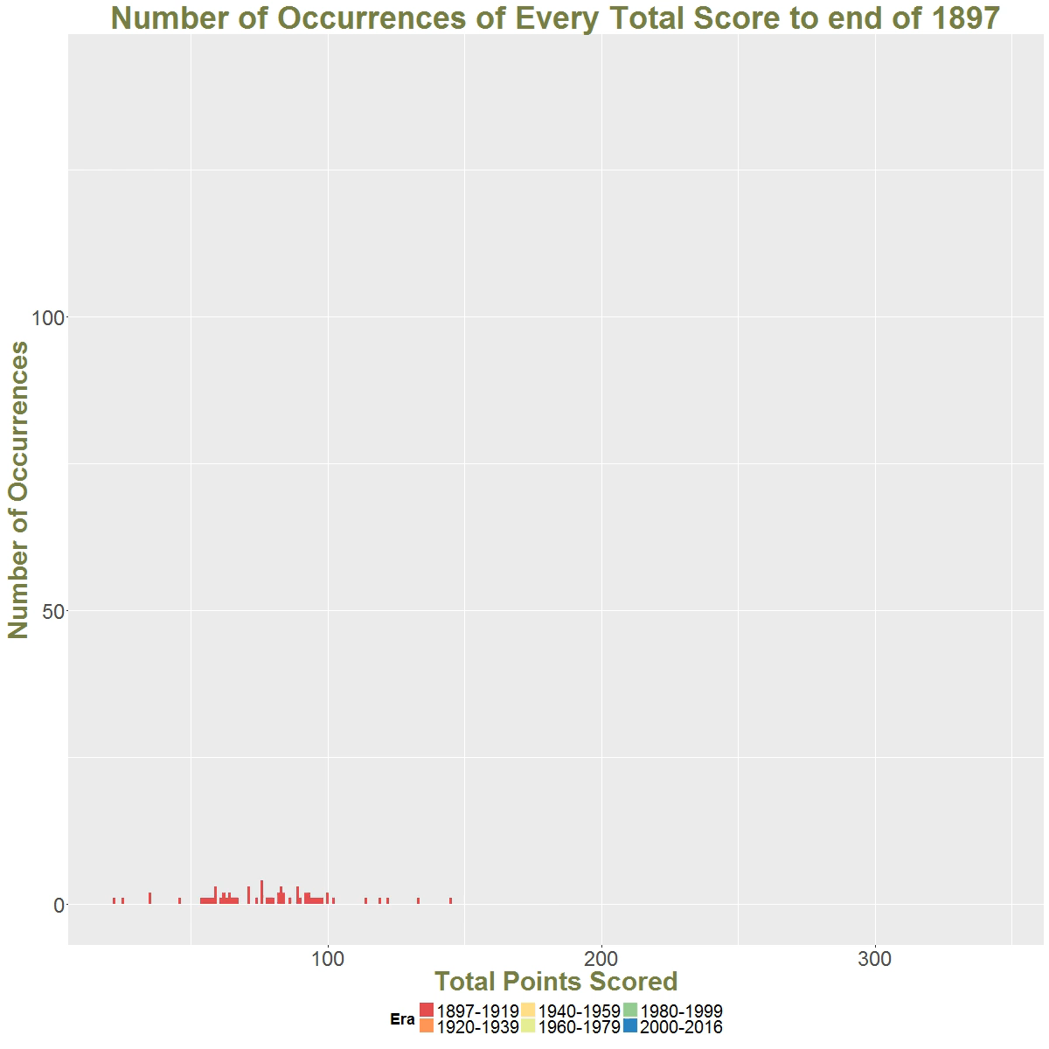
Some Other Visualisations
37

Slide 38
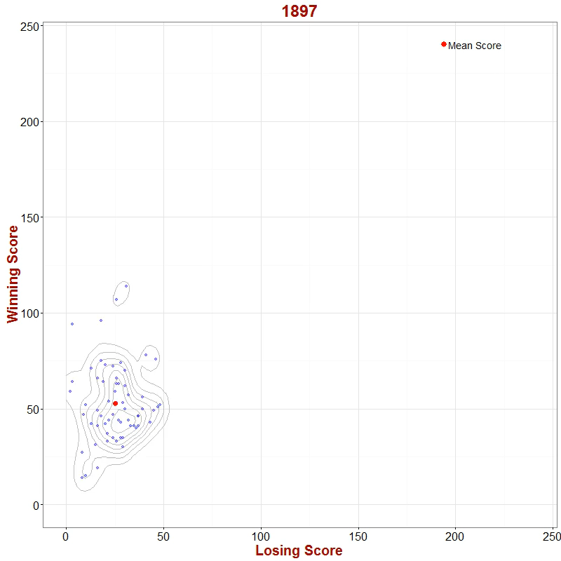
Some Other Visualisations
38

Slide 39
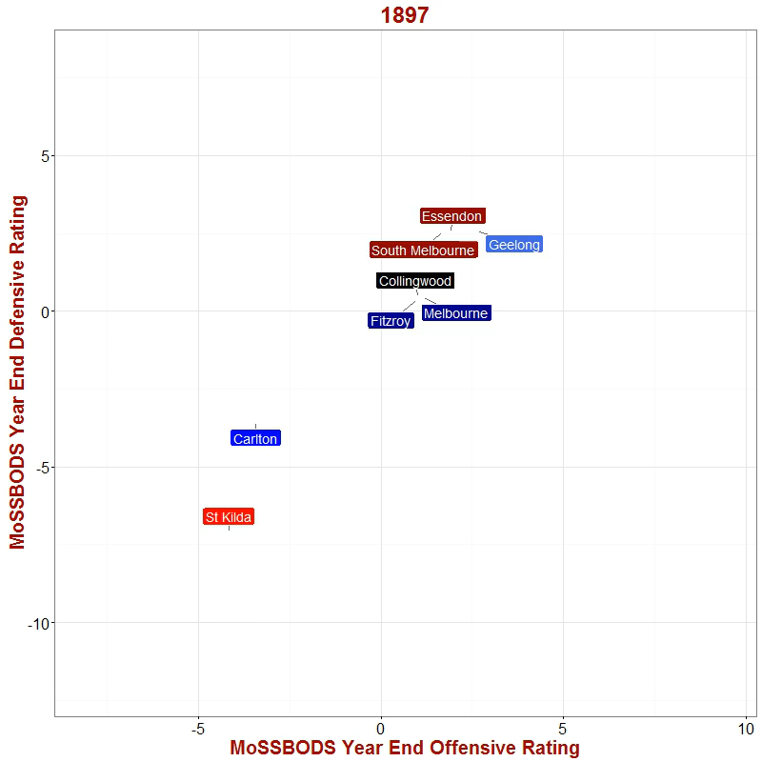
Some Other Visualisations
39

Slide 40
MoSSBODS Next?
Reconsider Travel Penalty
  different for each team and venue?
  relate to distance?
  exclude?
Weight Goals and Behinds differently
  Currently 1:1
  6:1 seems too extreme …
Vary Scoring Shot Conversion Rate
  Account for Venue, Time of Date, Month etc
  Use Own Offensive and Opponent Defensive Ratings
40

